Slide 1
Acworth Minority, Women, and Veteran Owned Business Seminar
Carolina Ramon
Lloyd Atkins
November 12, 2020

Slide 2
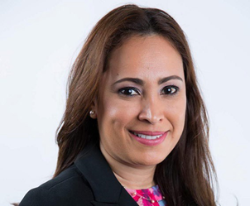

Carolina Ramon
Director, Minority Business Division
MBA in Finance, GSU
Federal Procurement Certifications
Supply Diversity
Financing
cramon@lgeorgiasbdc.org

Slide 3
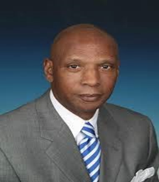
Lloyd Atkins
Business Consultant, Minority Business Division
Federal and Local Procurement
Certifications (8a, Hubzone, MBE, WOSB, WBE
latkins@lgeorgiasbdc.org

Slide 4
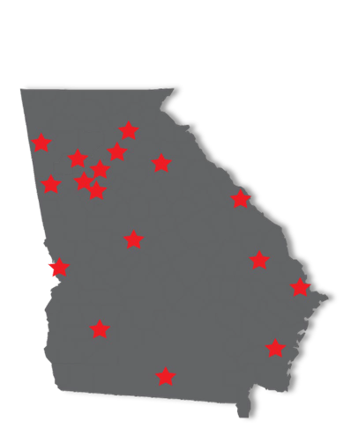

The UGA Small Business Development Center (SBDC)
Mission
Enhance the economic well-being of Georgians by providing a wide range of educational services for small business owners and aspiring entrepreneurs.

Slide 5
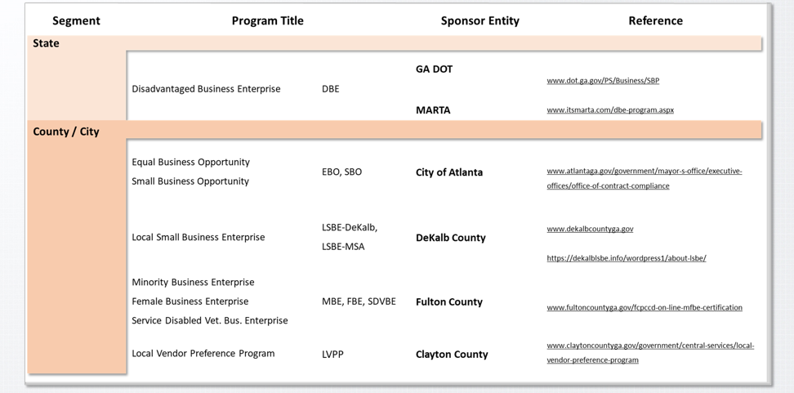
State of GA Small Business Contracting

Slide 6
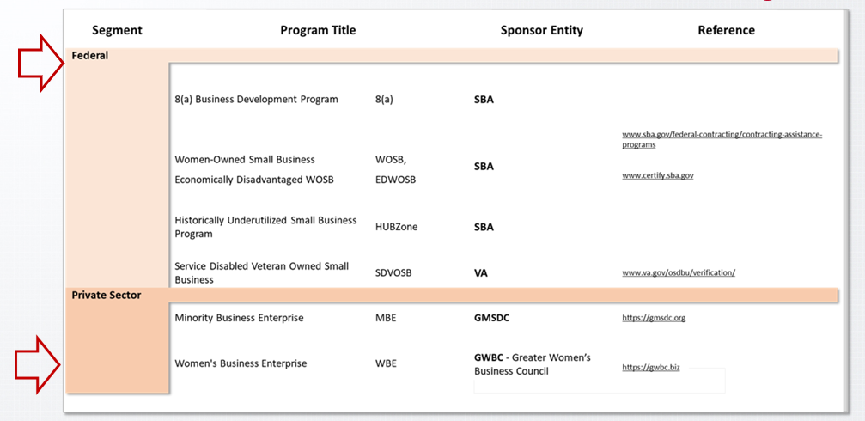
State of GA Small Business Contracting

Slide 7

What is the Women-Owned Small Business Program Federal Contracting Program?

Slide 8

How can I apply to become as a WOSB or EDWOSB?

Slide 9
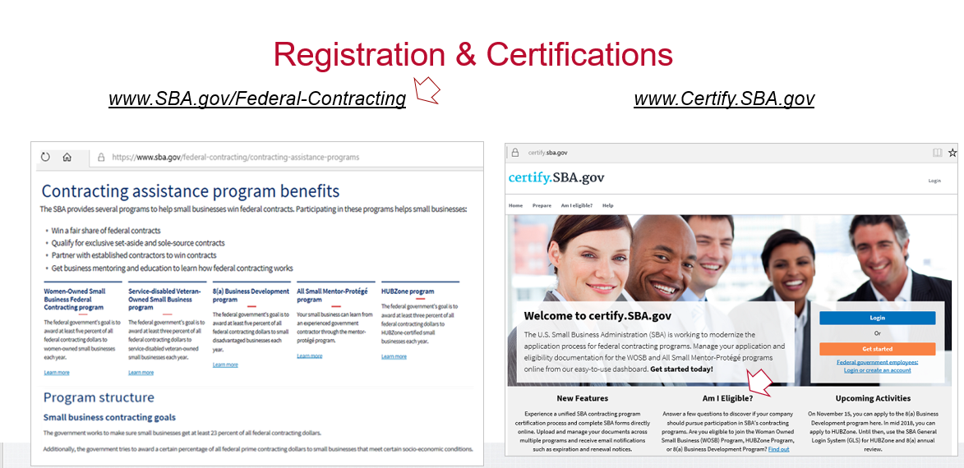

Slide 10

How does the SBA define a Woman- Owned Small Business & Economically Disadvantaged
Woman-Owned Small Business ?

Slide 11
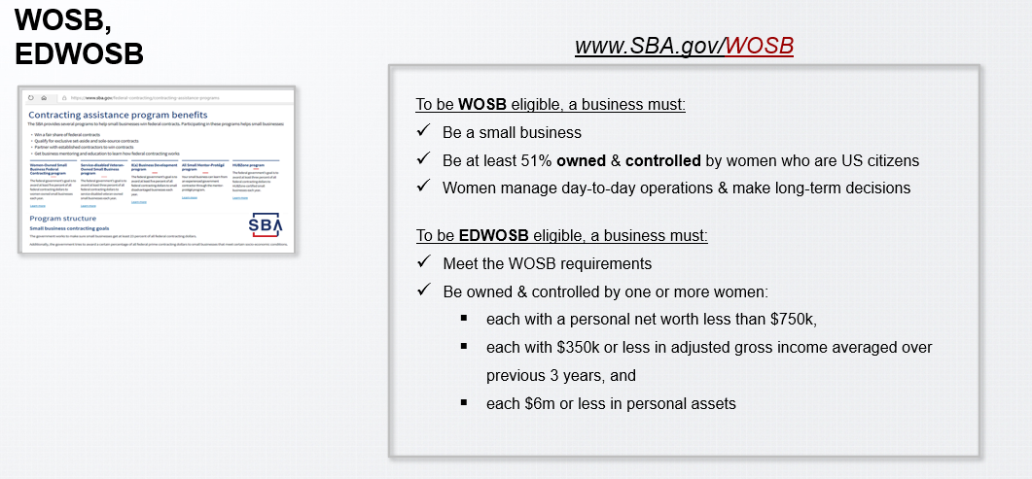

Slide 12

What Is A Third-Party Certifier?

Slide 13
The SBA will post a list of approved Third-Party Certifiers at www.sba.gov/WOSB
The SBA has currently authorized the following organizations as third-party certifiers:
The Women’s Chamber of Commerce
National Association of Women Business Owners
Women’s Business Enterprise National Council
The Hispanic Chamber of Commerce of El Paso, Texas

Slide 14
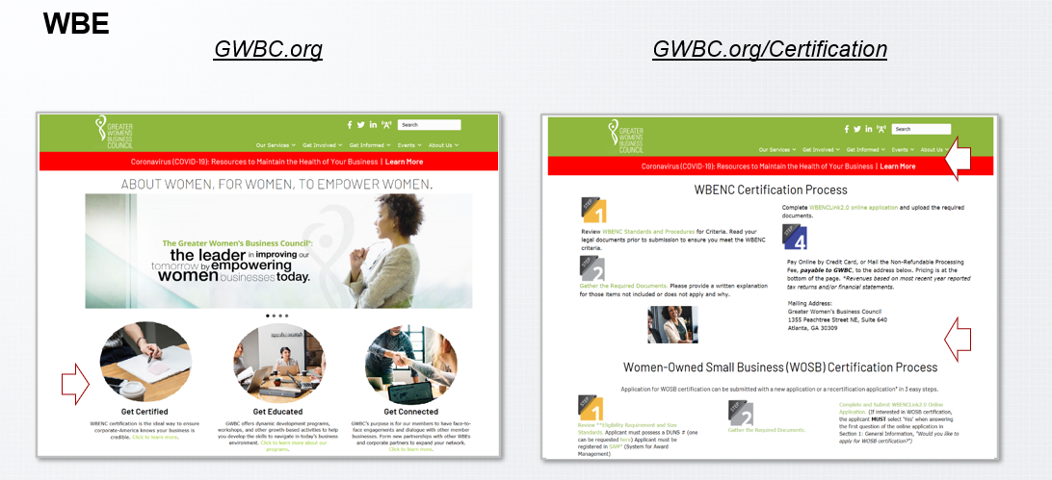

Slide 15
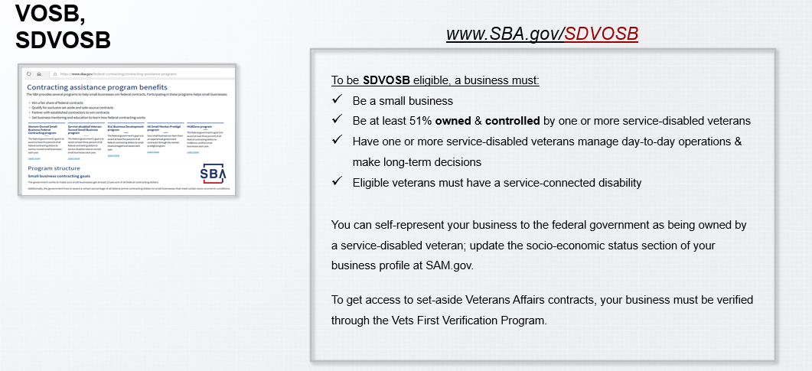

Slide 16
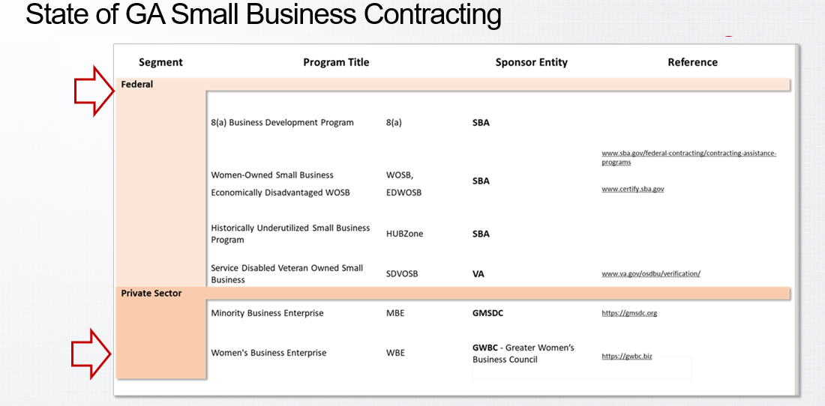

Slide 17

Thank You.
For more info visit: www.georgiasbdc.org/minority
(470) 268-5793
ombd@georgiasbdc.org

